Slide 1
Cyber-Financial Crime
Independent Variable = Cyber-Financial Crime
Dependent Variable = Effects on Mental Health
By
Pranav Prakash
Aman Aggarwal
Sukirat Singh

Slide 2
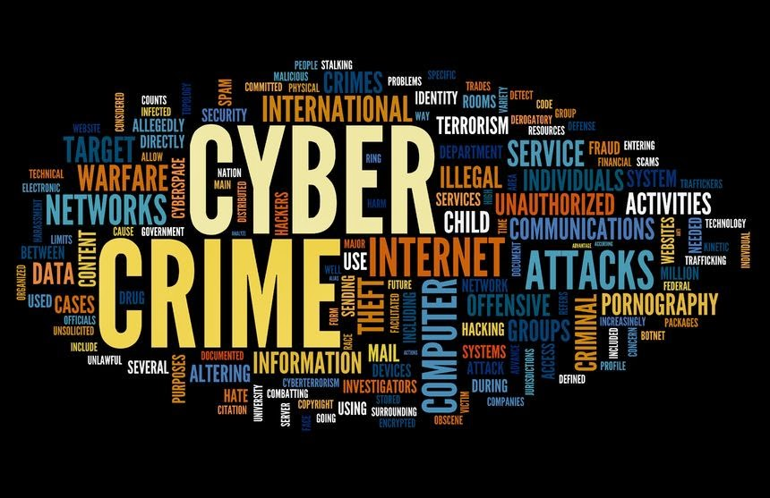

Unveiling Cyber Financial Crime: Safeguarding Your Assets in the Digital Age

Slide 3


Rising Cyber Threats: Unveiling India's Data Security Landscape

Slide 4


Age Groups Affected

Slide 5
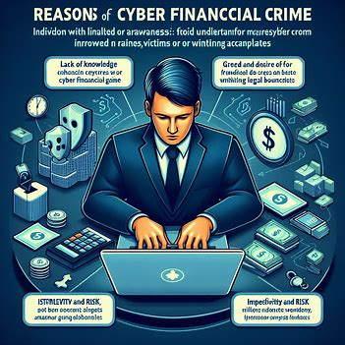

Reasons for Occurrence
.

Slide 6
Effects on Mental Health due to Cyber Financial Crime

Slide 7

Persistent fear and paranoia about personal and financial security online.

Slide 8

Shame and Embarrassment:

Slide 9

Post-Traumatic Stress Disorder (PTSD):

Slide 10
Let’s See what our Audience thinks about it

Slide 11
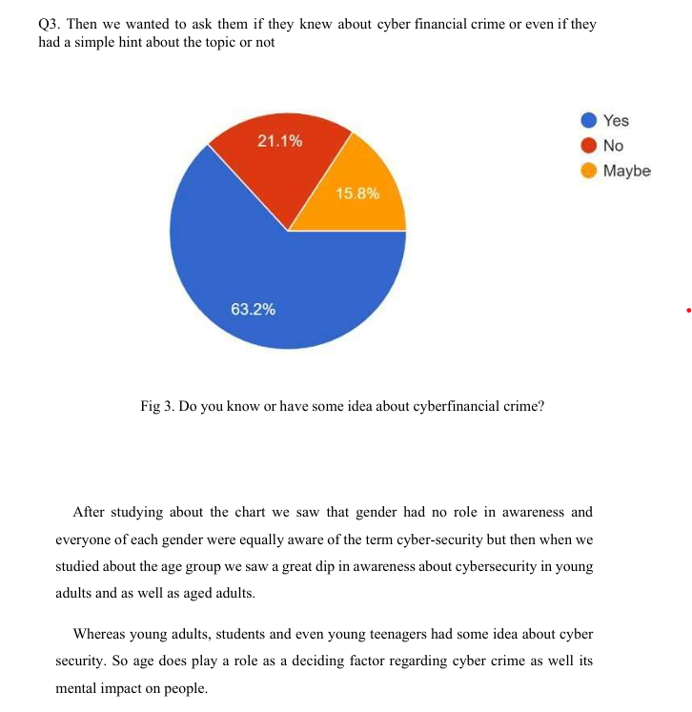

Slide 12
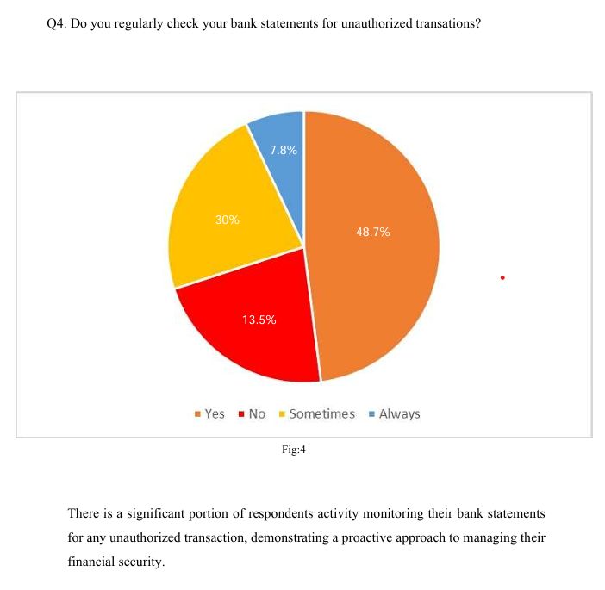

Slide 13
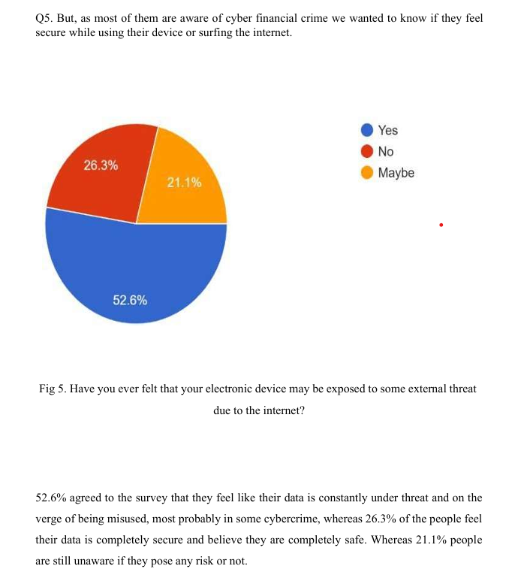

Slide 14
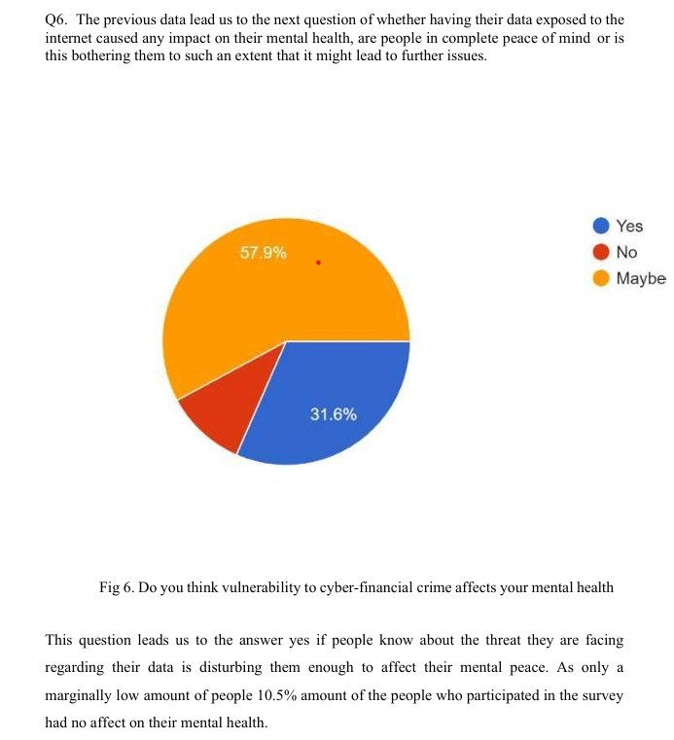

Slide 15
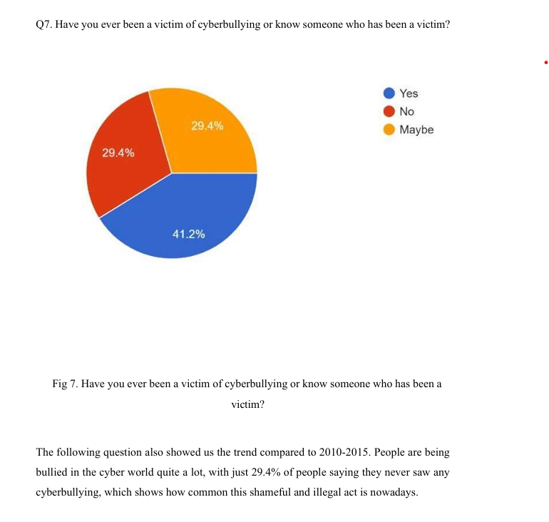

Slide 16
Harmful Effects of Cyber Financial Crime on Individuals

Slide 17

Identity Theft Leading to Long-Term Credit Issues

Slide 18


Financial Loss and Debt:

Slide 19


Emotional Distress, Anxiety, and Psychological Impacts:
.

Slide 20

Preventions & Protection

Slide 21
Thank you
.

